Slide 1
Discuss the changing ideals of American womanhood between the American Revolution (1770s) and the outbreak of the Civil War. What factors fostered the emergence of “republican motherhood” and the “cult of domesticity”? Assess the extent to which these ideals influenced the lives of women during this period. In your answer be sure to consider issues of race and class.
Use documents and your knowledge of the time period in constructing your response.

Slide 2
Step 1: Deconstruct Prompt
1. What is the MAIN TOPIC of your paper?
2. In what way are you asked to analyze this topic?
3. What are the sub topics that must be included?

Slide 3
Prompt Deconstruction
1. Main Topic: Womanhood (Revolution War-Civil War)
2. How you’re asked to analyze: Factors that lead to the start of “republican motherhood” and “cult of domesticity”
3. Required subtopics:
A. How did these (“republican motherhood” and “cult of domesticity” influence women?
B. Consider race/class

Slide 4
Step 2: Background Information
Outline your response to the essay prompt using ONLY the background information. Make sure your outline includes all information required within the prompt. Do additional research if necessary.

Slide 5
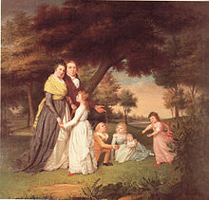
Republican Motherhood
-Prominent attitude towards women’s role in society surrounding the American Revolution. Revolves around the belief that it is the woman’s role to foster and pass on the republican values to the next generation. Women were to sacrifice their own needs in order to instill the values of Patriotism in their children for the good of the entire country. Sons were raised to be civic minded while girls were raised to inherit the role of educating the next generation.
Ideals of Enlightenment
John Locke: "[T]he first society was between man and wife, which gave beginning to that between parents and children... conjugal society is made by a voluntary compact between man and woman."

Slide 6
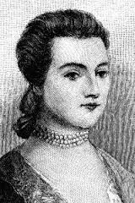
Republican Motherhood
Significant figure to reference: Abigail Adams
"...remember the ladies, and be more generous and favorable to them than your ancestors. Do not put such unlimited power into the hands of the Husbands. Remember all Men would be tyrants if they could. If particular care and attention is not paid to the Ladies we are determined to foment a Rebellion, and will not hold ourselves bound by any Laws in which we have no voice, or Representation."

Slide 7
Republican Motherhood
PROS | CONS

Slide 8
Republican Motherhood
PROS | CONS

Slide 9
Influence on Women
-Rise in abolitionism among women. WHY?
-Seneca Halls Convention (1848) and the beginning of the fight for women’s rights.

Slide 10
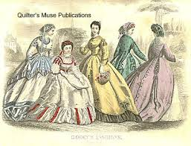
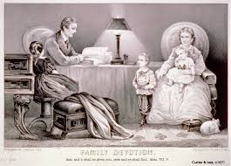
Cult of Domesticity
“Culture of true womanhood”
Emphasized the role of women within the home, their “proper sphere”.
“True Women” must abide by four cardinal virtues:
Piety- Religion (controlled longings)
Purity- Virginity must be saved for husband.
Submission- Obedient to their husbands because men were regarded as their superior.
Domesticity- Keeping a proper home for husband and raising children.
“Perfection of motherhood.. Is the wife and mother.” – Godey’s Lady Book

Slide 11
Culture of Domesticity
Class Gap: Prominent among upper and middle classes.
“True Women” were soft and delicate. Therefore, black, working class, and immigrant women did not meet the requirements of femininity.

Slide 12
Impact
Married women were not permitted to work. In 1890, 4.5% of all married women were employed compared to 40.5% of single women.
When husbands died or left their family the woman lost her power and had little economic support.
Cult of Domesticity met HUGE opposition from women who advocated for women’s rights. Led to the creation and strengthening of feminism. Those opposed to the Cult of Domesticity met at the Seneca Falls Convention in 1848, issued the Declaration of Sentiments, and inevitably led to women’s suffrage in 1920.

Slide 13
Step 3:
Using the template given, organize all information.

Slide 14
Step 4: Analyze Documents
 | What does this say? | How does it relate? | What main factor? | What sub factor? | Text Evidence
A
B
C
D
E
F
G
H
I
J

Slide 15
Step 5: Create Outline
Introduction Paragraph:
Background
Thesis
Body Paragraphs:
Claim
Evidence (What DOC are you using to support your claim?)
Argument

