Slide 1
Warring with the Natives
Pequot war, King Philip’s war, and the French and Indian war

Slide 2
Essential Questions in this module:
EQ 6: What effect did the King Phillips War have on both the colonists and Native Americans?
EQ 7: What were the lasting consequences of the French and Indian War?

Slide 3
The Pequot War of 1637
Context: The small pox epidemic destroyed much of the Native American settlements leaving a power vacuum. Each tribe sought political power as well as control of the fur trade. The Algonquian, Mohegan, Narragansett, Pequot, and Wampanoag tribes allied with different European settlements in order to gain the upper hand and increase their control over the other.

Slide 4
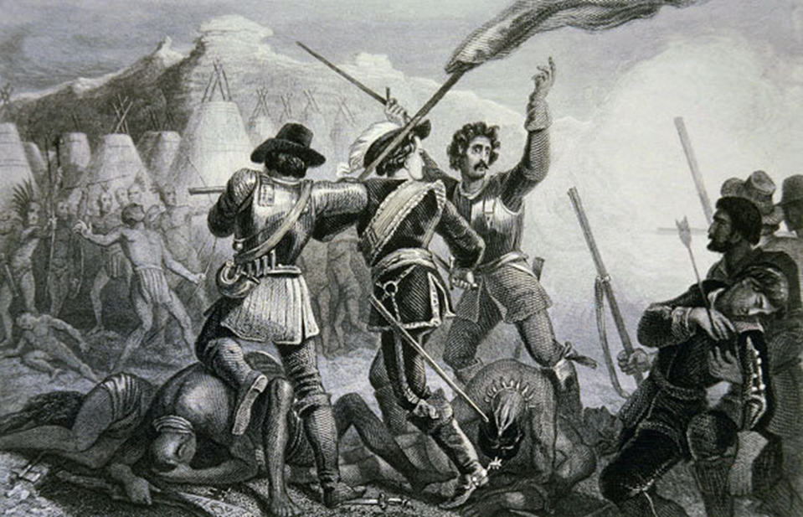
The Pequot War of 1637
Cause: (1) Rivaling Indian tribes sought political power and dominance in New England. (2) Puritan settlement was expanding into neighboring tribal areas.
Course: Mohegan’s allied with the English in order to eliminate the Pequot threat. A series of skirmishes and attacks resulting in deaths on both sides took place through the year 1637. On May 23rd, 1637 a Puritan militia and its Mohegan allies attacked the Pequot village at mystic and massacred its inhabitants. On June 5th they entered the village at Stonington and massacred the inhabitants and after a 3rd attack on July 28th, the war was over.
Consequence:
The Mohegan and Narraganset tribes divided Pequot lands.
The Puritans sold the remaining Pequot’s into slavery in the West Indies.
The Algonquian tribes experienced their first taste of “English style warfare”.
Relative peace among Natives and English in New England for the next 40 years.

Slide 5
King Philip’s War Your assignment:
Read through the background information provided. Take notes on the cause, course, and consequence of King Philip’s War.
Compare and contrast King Philips perspective of the war to that of the colonist by analyzing the primary sources given. Complete a DOC LOG for each document.
Answer the following questions:
DOC A:
1. Given who wrote it, do you think it’s fair to call the document King Philip’s Perspective? Why or why not?
2. What was happening in New England that led to this meeting?
3. What are 3 complaints that the Native Americans made to John Easton?
DOC B:
4. What are three different theories that the colonists have for why Indians attacked English settlements? Do the colonists blame themselves? Explain.
5. How would you describe the colonists’ attitude towards Native Americans?

Slide 6
PICK A SIDE! Natives or Colonists?
Using evidence from Documents A and B, write a letter home describing the war and its outcome. Be sure to include what do you think caused King Philip’s War of 1675?

Slide 7
Revisit your EQ
Homework: Conduct background research focusing on the cause, course, and consequences of the French and Indian War.
Complete a DOC LOG for The Albany Plan of Union.
Research and take notes on what the Albany Congress was, what its objective was, and why it failed.

Slide 8
The French and Indian War (The Seven Year’s War)
“The volley fired by this young Virginian in the forests of America has set the world in flames.” ~British author Horace Walpole
Thought by many to be the War that Made America. As we work our way through this lesson I want you to take notes as to why the French and Indian War may be described this way.

Slide 9
Context:
The French were late comers to New World exploration
Dealing with internal strife (Catholics v Protestants)
Established there first colony in Quebec in 1608 (same year as Jamestown)
During the reign of Louis XIV became a strong nation and sought to increase overseas settlements
The French and Indian War is the American theater of a much larger Seven Years War that engulfed all of Europe. In the 1750s Europe was ablaze in conflict over political dominance and religious control. Actors included Britain, France, Spain, Prussia, Russia, Portugal, Austria, and Sweden. Each country allied with those most capable of assisting them in their quest for domination.
The American Theater was primarily fought between France and Great Britain, referred to as the French and Indian War.

Slide 10
New France Color map and keep in notebook
A series of skirmishes broke out between French, Spain, and British colonies but were mainly fought between colonists and Indian allies.
The area of contention that escalated into an international war was the Ohio River Valley.
George Washington, a 21 year old lieutenant, was sent to the Ohio River Valley with 150 militiamen to secure Virginia’s holdings.
Washington encountered a detachment of French troops, Virginians shot and killed the leader- started the war.

Slide 11
What do you think the message behind this image is?
Read through the Albany Plan of Congress and summarize their specific objectives in creating a unified front.
Red: 3-6
Green: 7-10
Blue: 11-14
Purple: 15-18
Orange: 19-21
Yellow: 22 & 23
Highlight:
1. Specific reasons why the colonies would not approve the plan. 2. Specific reasons why Britain would not approve the plan.

Slide 12
Your assignment: Using the textbook create a poster detailing the cause, course, and consequences of the French and Indian War.
Cause | Course | Consequence (Effects)
As a group: determine why you believe the French and Indian War is considered the war that made America.

Slide 13
Revisit your EQ.
Refer to your EQ Rubric

